Slide 1
MPI Collective Communication
CDP

Slide 2
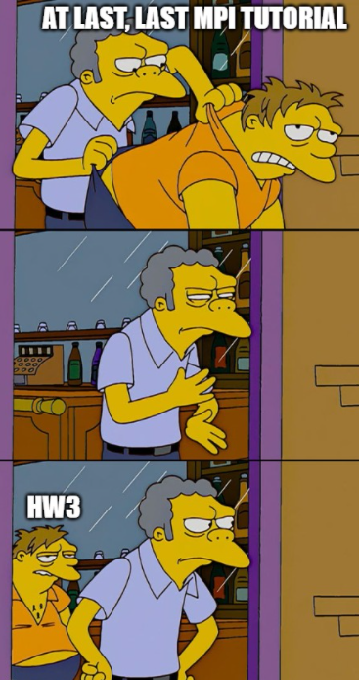
And don’t forget the exam!

Slide 3
MPI Collective Communication
Can be interpreted as communications involving more than two participants.
Collective communication routines in MPI:
Barrier synchronization
Broadcast from one member to all other members
Scatter data from one member to all other members
Gather data from all members to one member
All-to-all exchange of data
Global reduction (e.g., sum, min of "common" data element to one node)
Scan across all members of a group
Implemented using P2P communication routines.
These routines are very common in many applications.
Synchronization, data movement, and global computation
Helpful Site

Slide 4
Collective communication routines characteristics
Coordinated communication within a group of processes
Identified by an MPI communicator
No message tags are needed
Substitute for a more complex sequence of point-to-point calls
All routines block until they are locally completed
Starting from MPI 1.7, non-blocking collective communication is supported
In some cases, a root process originates or receives all data
Amount of data sent must exactly match amount of data specified by receiver
Notes:
As we seen on the first MPI tutorial, the communicator determines who can send message to who, in the default COMM_WORLD case, we allow every process to communicate with every process.

Slide 5
Barrier synchronization routine
A synchronization primitive
Blocking until all the nodes in the group have called it
comm.Barrier()
comm: a communicator
Notes:
This is something that you have seen in OS and we reminded it earlier both in the python tutorial and also in the context of GPUs (cuda.syncthreads())

Slide 6
Data movement routines - Broadcast
One processor sends data to all the processes in a group
Bcast(buffer, root)
Must be called by each node in the group, specifying the same comm, root and count
Bcast(buffer, root=1)
buffer
 |  |  | A | 1 | processes
 |  |  |  | 2
 |  |  |  | 3
 |  |  |  | 4
buffer
 |  |  | A | 1 | processes
 |  |  | A | 2
 |  |  | A | 3
 |  |  | A | 4
Broadcast
Notes:
Here both the sender and the receiver call Bcast,

Slide 7
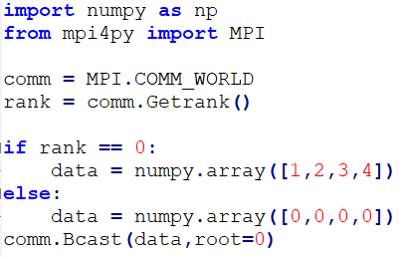
Broadcast Example
Notes:
Note the capital B here. (Using lower case will use pickle)

Slide 8
Gather and Scatter
comm.Scatter(sendbuf, recvbuf, root)
comm.Gather(sendbuf, recvbuf, root)
sbuf / rbuf
D | C | B | A | 1 | processes
 |  |  |  | 2
 |  |  |  | 3
 |  |  |  | 4
Scatter
rbuf / sbuf
 |  |  | A | 1 | processes
 |  |  | B | 2
 |  |  | C | 3
 |  |  | D | 4
Gather
Notes:
Note: Gather and Scatter are based on the rank of each process.

Slide 9
Scatter
Scatter sets of 100 ints from the root to each process in the group
At all processes
comm.Scatter(None, rbuf, root=0)
At root = 0
comm.Scatter(sbuf, rbuf, root=0)
100
100
100
At all processes
100
100
100
At root
sbuf
9
Notes:
What is the size of sbuf?
You can send less elements than you intend to receive, but the receiver cannot check how many items actually received

Slide 10
Code Example: Scatter
comm = MPI.COMM_WORLD
rank = comm.Get_rank()
size = comm.Get_size()
a_size = 4
senddata = None
recv_buffer = np.empty(a_size,)
if rank == 0:
senddata = np.arange(size * a_size, dtype=np.float64)
comm.Scatter(senddata, recv_buffer , root=0)
print("on task", rank, "after Scatter: data = ", recvdata)
Notes:
on task 0 after Scatter: data= [0. 1. 2. 3.]
on task 1 after Scatter: data= [4. 5. 6. 7.]
on task 3 after Scatter: data= [12. 13. 14. 15.]
on task 2 after Scatter: data= [ 8. 9. 10. 11.]

Slide 11
Gather
Gather sets of 100 ints from the group to the root.
At all processes
comm.Gather(sbuf,None,root=0)
At root=0
comm.Gather(sbuf,rbuf,root=0)
100
100
100
At all processes
100
100
100
At root
rbuf

Slide 12
Code Example: Gather
comm = MPI.COMM_WORLD
rank = comm.Get_rank()
size = comm.Get_size()
a_size = 4
recvdata = None
senddata = (rank + 1) * np.arange(a_size, dtype=np.float64)
if rank == 0:
recvdata = np.arange(size * a_size, dtype=np.float64)
comm.Gather(senddata, recvdata, root=0)
print("on task", rank, "after Gather: data = ", recvdata)
Notes:
on task 1 after Gather: data = None
on task 2 after Gather: data = None
on task 0 after Gather: data = [0. 1. 2. 3. 0. 2. 4. 6. 0. 3. 6. 9.]

Slide 13
Gatherv and Scatterv
Allow each node to send/receive a different number of elements
comm.Gatherv(sbuf, [rbuf,counts,dspls,type], root)
comm.Scatterv([sbuf,counts,dspls,type], rbuf, root)
Notes:
בGATHERV אני מגדיר איך לשבץ את BUFFER היעד שלי
בSCATTERV אני מגדיר את החלוקה של המידע מתוך BUFFER המקור שלי

Slide 14
Gatherv
At all processes:
comm.Gatherv(sbuf, None, root);
At root = 0:
rcount = [30,70,120]
displs = [0,30,100]
comm.Gatherv(sbuf, [rbuf, rcount, displs, type], root);
30
70
120
At all processes
At root
displs[0]
Displacement differences must be larger than the corresponding rcounts entry
displs[1]
displs[2]
rbuf
Notes:
Allows scatter/gather only a part of your data without having to pack it to a new array

Slide 15
Code Example: Gatherv
comm = MPI.COMM_WORLD
rank = comm.Get_rank()
size = comm.Get_size()
a_size = 4
recvdata = None
senddata = (rank + 1) * np.arange(a_size, dtype=np.float64)
counts = (2, 3, 4)
dspls = (0, 2, 5)
if rank == 0:
recvdata = np.empty(9, dtype=np.float64)
sendbuf = [senddata, counts[rank]]
recvbuf = [recvdata, counts, dspls, MPI.DOUBLE]
comm.Gatherv(sendbuf, recvbuf, root=0)
print("on task", rank, "after Gatherv: data = ", recvdata)
Notes:
on task 2 after Gatherv: data = None
on task 1 after Gatherv: data = None
on task 0 after Gatherv: data = [0. 1. 0. 2. 4. 0. 3. 6. 9.]

Slide 16
Allgather
comm.Allgather(sbuf, rbuf)
comm.Allgatherv(sbuf, [rbuf,counts,dspls,type])
sbuf
 |  |  | A | 1 | processes
 |  |  | B | 2
 |  |  | C | 3
 |  |  | D | 4
rubf
D | C | B | A | 1 | processes
D | C | B | A | 2
D | C | B | A | 3
D | C | B | A | 4
All Gather
Notes:
Can be interpreted as Gather+Broadcast

Slide 17
All to All
comm.Alltoall(sbuf, rbuf)
sbuf
D¹ | C¹ | B¹ | A¹ | 1 | processes
D² | C² | B² | A² | 2
D³ | C³ | B³ | A³ | 3
D⁴ | C⁴ | B⁴ | A⁴ | 4
rbuf
A⁴ | A³ | A² | A¹ | 1 | processes
B⁴ | B³ | B² | B¹ | 2
C⁴ | C³ | C² | C¹ | 3
D⁴ | D³ | D² | D¹ | 4
All to All
Notes:
scount must be equal to rcount; there is a variants that allows different data sizes and types
Note: Gather and Scatter are based on the rank of each process.
In this case can be seen either as everyone gathers or everyone scatters

Slide 18
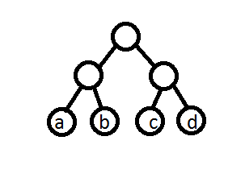
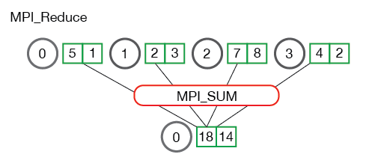
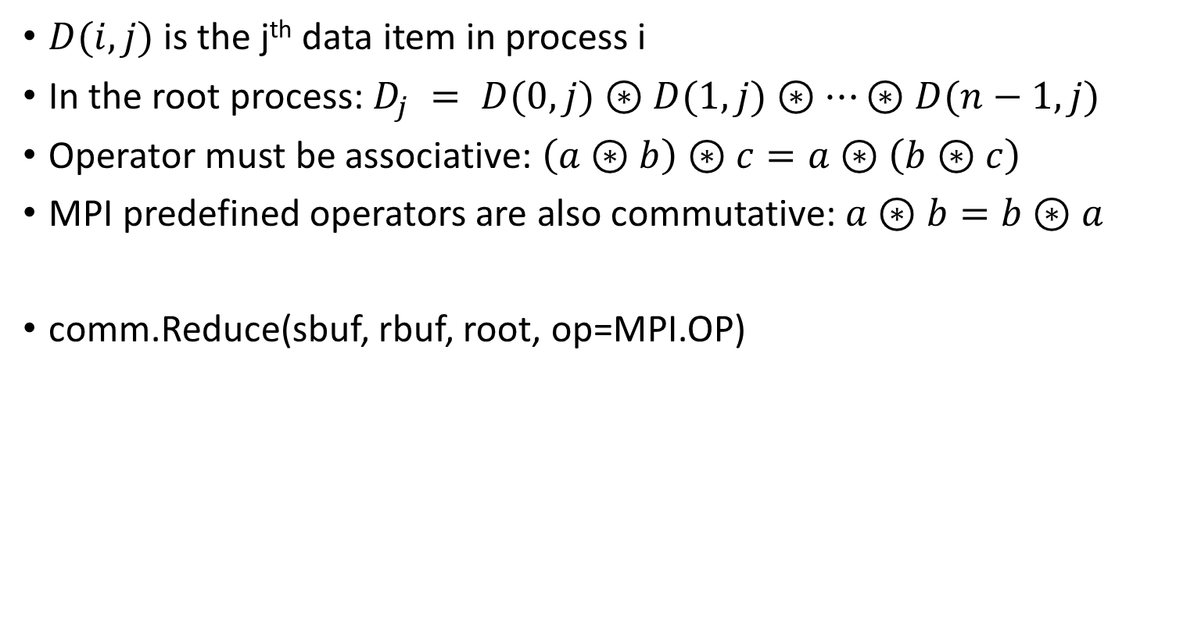
Global computation routines Reduce
$D(i,j)$is the j^{th} data item in process i
In the root process: $D_{j} = D(0,j)⊛D(1,j)⊛…⊛D(n−1,j)$
Operator must be associative: $\left(a⊛b\right)⊛c=a⊛\left(b⊛c\right)$
MPI predefined operators are also commutative: $a⊛b=b⊛a$
comm.Reduce(sbuf, rbuf, root, op=MPI.OP)
Notes:
Associative: allows tree form calculation. lIf the operator was not associative, (a+b)+(c+d) != (((a+b)+c)+d)
Commutative: allows further optimization (e.g. calculate when data ready, no need to keep partial sum)

Slide 19
Global computation routines AllReduce + Reduce_Scatter
comm.Allreduce(sbuf, rbuf, op=MPI.OP)
Access the reduced data on all processors rather than the root process
comm.Reduce_scatter (sbuf, rbuf, recvcounts, op=MPI.SUM)
recvcounts indicate the number of elements in result distributed to each process (vector)
Rbuf must match the recvcounts (cannot be smaller than recvcounts)
Notes:
Remember RingAllReduce? That is a very nice implementation for AllReduce using P2P comms

Slide 20
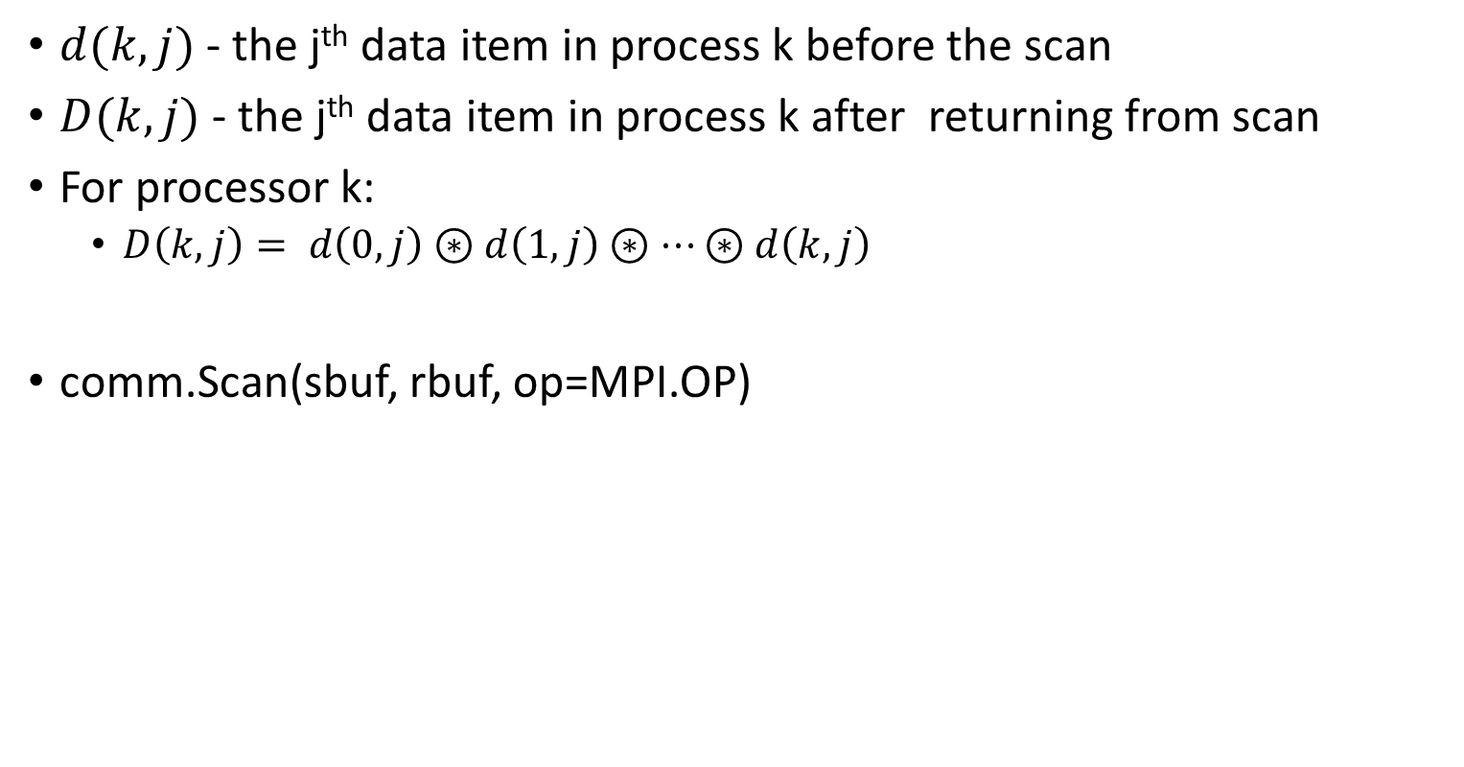
Scan
$d(k,j)$- the j^{th} data item in process k before the scan
$D(k,j)$- the j^{th} data item in process k after returning from scan
For processor k:
$D\left(k,j\right)= d\left(0,j\right)⊛d\left(1,j\right)⊛…⊛d\left(k,j\right)$
comm.Scan(sbuf, rbuf, op=MPI.OP)
Notes:
A reduction means all processors get the same value while scan returns the partial operation results on each processor. For instance, if you had 10 processors and you were taking the sum of their rank, MPI_Reduce would give you the scalar 45 (0+1+2+3+4+5+6+7+8+9) on the root process only while MPI_scan would give you the scalar of the reduction up to the rank of the processor on each processor. So processor 0 would get 0, processor 1 would get 1, processor 2 would get 3, and so on. Processor 9 would get 45.
>> http://stackoverflow.com/questions/12966446/in-mpi-how-do-reduce-and-scan-differ
Where we should’ve used it before?

Slide 21
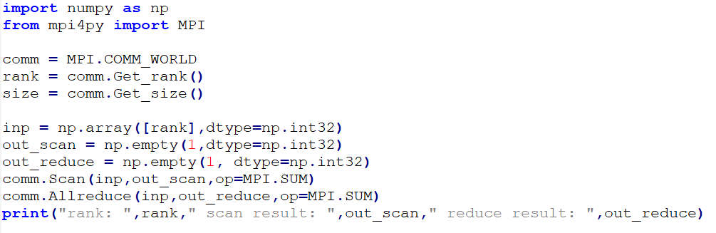
Code Example – Scan versus Reduce

Slide 22
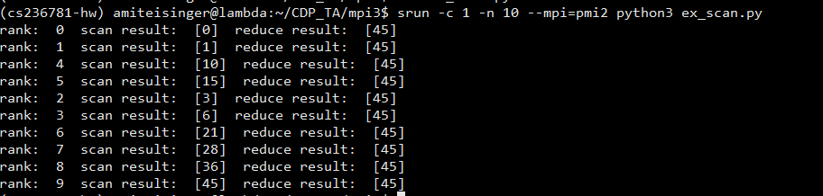
Output

Slide 23
Predefined reduce operations
Name | Meaning | C type
MPI.MAX | maximum | integer, float
MPI.MIN | minimum | integer, float
MPI.SUM | sum | integer, float
MPI.PROD | product | integer, float
MPI.LAND | logical and | integer
MPI.BAND | bit-wise and | integer, MPI_BYTE
MPI.LOR | logical or | integer
MPI.BOR | bit-wise or | integer, MPI_BYTE
MPI.LXOR | logical xor | integer
MPI.BXOR | bit-wise xor | integer, MPI_BYTE
MPI.MAXLOC | max value and location | combination of int, float, double, and long double
MPI.MINLOC | min value and location | combination of int, float, double, and long double
Notes:
MPI.MAXLOC and MPI.MINLOC allows to use complex types such as MPI_FLOAT_INT, MPI_DOUBLE_INT, etc.
The op will be done on the first element (i.e. in MPI_FLOAT_INT: on the float) but the second will also be returned.
This gives more information about the item (e.g. index)

Slide 24
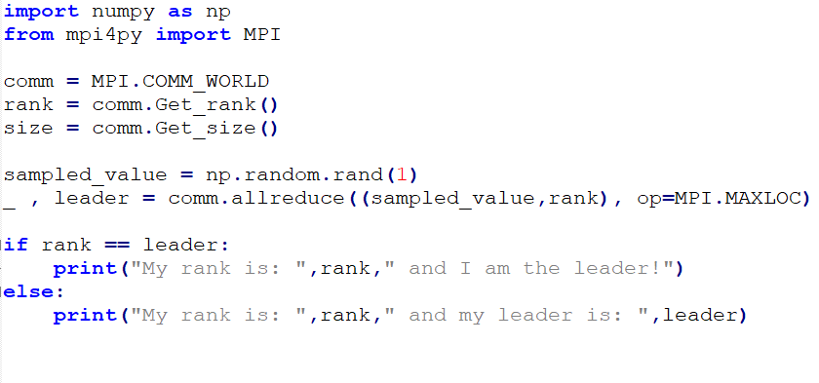
Example – Choosing a random leader using MPI.MAXLOC
Notes:
Using MAXLOC and MINLOC with Allreduce and Reduce doesn’t work in our version of MPI. So we use here the lower case version

Slide 25
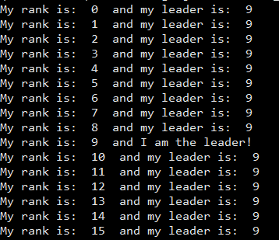
Output

Slide 26
Performance issues
A great deal of hidden communication takes place with collective communication
Performance depends greatly on the implementation of MPI
Because there may be forced synchronization at the end of the used function, not always best to use collective communication

